Slide 1
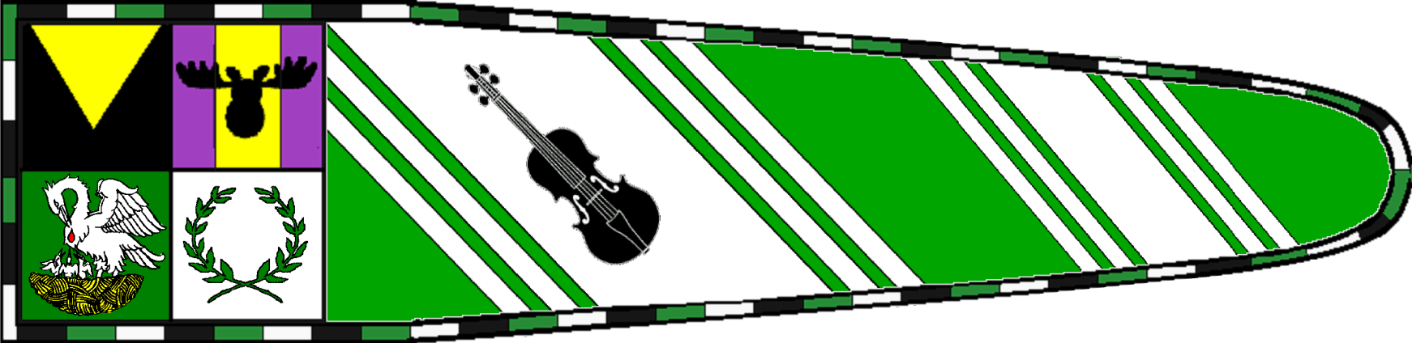
Silk Standards
Presentation by Giliana Attewatyr, OL
amefinch@gmail.com

Slide 2
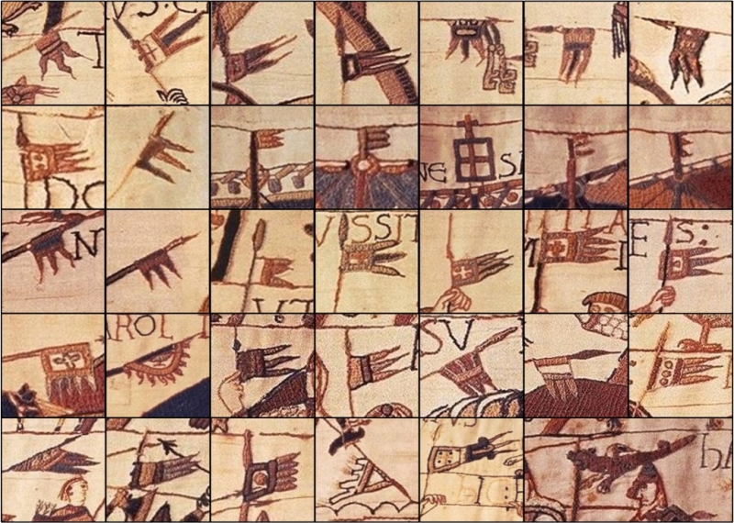
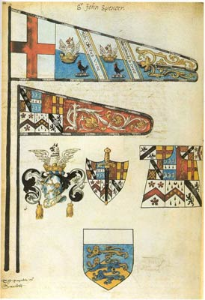
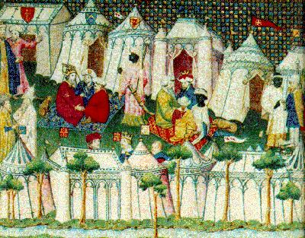
History of the Standard
Flags, pennants, standard and other shapes/uses can be seen in illuminations and other art forms through time.
Some examples:
Tapestries from Bayeux Tapestry
Funereal Certificate for Sir John Spencer 1599
Flags with pavilions, banners and pennants, 14th C.
Notes:
Description: "High-ranking lords did not renounce their customary comforts even on the battlefield. The illustration shows a negotiation scene in tents, fourtheenth century. Bibliothèque Nationale, Paris."
Credit: Paris Bibliothèque Nationale; ms. français 12559.
Source: Neubecker
Comments: There are quite a few flags in this picture. Almost all appear to be flying from extensions of the tent poles except the one in the upper left, between the second and third tents from the left. In my reading so far, I haven't discovered any mention of the heralic shields displayed on the roofs of several of the tents and assume they were perhaps wooden or display-only shields and not flags.

Slide 3
Methods and Materials
Medieval flags could be embroidered, appliquéd, or painted (including stamped), depending on their purpose and ownership.
  While embroidered flags were certainly impressive and durable, they were costly and time-consuming. Flags for display (especially indoors) and meant to impress certainly warranted this type of decoration.
  Appliquéd flags, on the other hand, could imitate the opulence of embroidered flags but could be mass produced and completed in much less time and with much less expense.
  Painted flags were inexpensive, more easily mass produced than appliqué flags, and could be achieved even faster when time was an issue. Painting techniques described by Cennini’s Il Libro dell’Arte.
Linen and silk most common
Good information found in Medieval painted flags: http://destrier.net/astonhall/article_medieval_painted_flags.20070501.pdf
Notes:
Description: "High-ranking lords did not renounce their customary comforts even on the battlefield. The illustration shows a negotiation scene in tents, fourtheenth century. Bibliothèque Nationale, Paris."
Credit: Paris Bibliothèque Nationale; ms. français 12559.
Source: Neubecker
Comments: There are quite a few flags in this picture. Almost all appear to be flying from extensions of the tent poles except the one in the upper left, between the second and third tents from the left. In my reading so far, I haven't discovered any mention of the heralic shields displayed on the roofs of several of the tents and assume they were perhaps wooden or display-only shields and not flags.

Slide 4
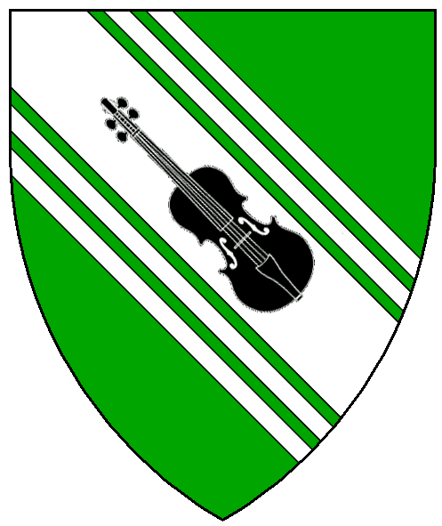
The Standard isn’t your Device
A device is very specific.
The standard is an interpretation.
They do not need to be the same!
Device and Pennant of Karl Braden von Sobernheim

Slide 5
Going from device to standard
Take heraldry element(s) and rearrange
Repeat elements
Omit elements
Add elements
  Family
  Household
  Group
  Awards
  Mottos/text

Slide 6
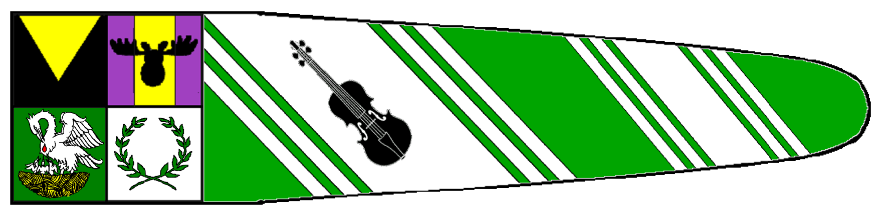
Adding Borders and Divisions
Adding dividers or borders
  Borders can add a finished look or pop to the standard
Without border
With border

Slide 7
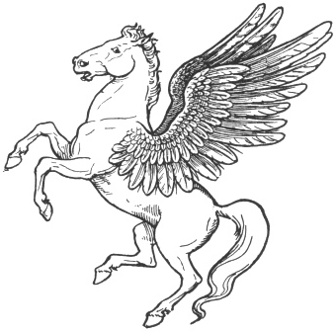
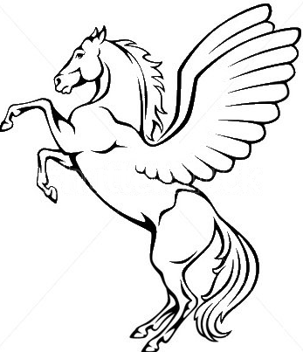
Make elements BIG and simple
Banner is 90” long so there is plenty of room!
Banner is 20' in the air and flapping in the breeze
Think large cartoon-type images; not a lot of small details
Only use small images, like ermine, in a repeating pattern
Too detailed
Simple outline

Slide 8


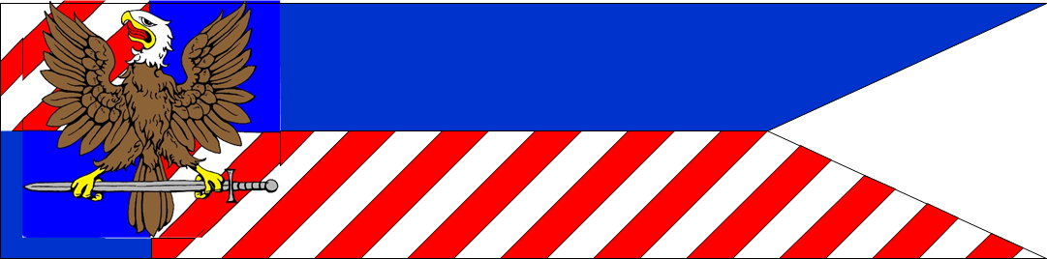


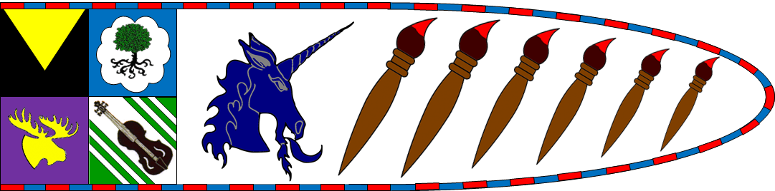
Put elements close to the pole
Banner is 20' in the air and flapping in the breeze
  As the banner flaps, any images or text at the tips is completely lost.
  Online Flag Waver(!!!) - https://krikienoid.github.io/flagwaver/
These banners are more centered. Far details will be lost.
These banners weighted to the pole. Easier to see in the breeze!

Slide 9
Put elements close to the pole
Put main identifiers (group, awards) directly against the pole
  The equivalent of “What army am I with?”
Put all main charges in first ⅓ to ½ of banner
The rest of the banner would be best to leave with bold colors and/or repeated patterns

Slide 10

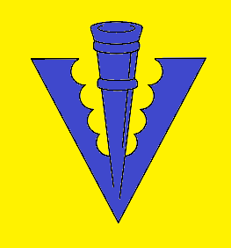
Heraldic rules are still a good idea!
The reason for no color on color or metal on metal is to increase visibility from a distance
Banner is 20' in the air and flapping in the breeze
Sometimes different divisions will have color next to color. Try to avoid extremely similar colors:
  Blue / Purple / Black
  Red / Orange
  Yellow / Orange
  Green / Blue
  Depends somewhat on your selected dyes
Hard to see
Easily visible

Slide 11




Layout process – Basic Shape
Simple rectangle
Single rounded taper
Single pointed taper
Double rounded taper
Double pointed taper

Slide 12

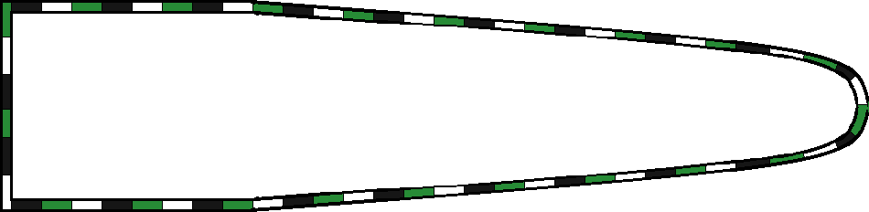
Layout process – Add a Border
Solid color
Stripes
Complex lines like embattled

Slide 13
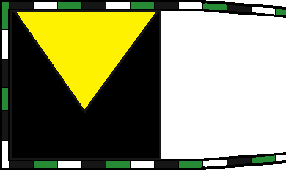
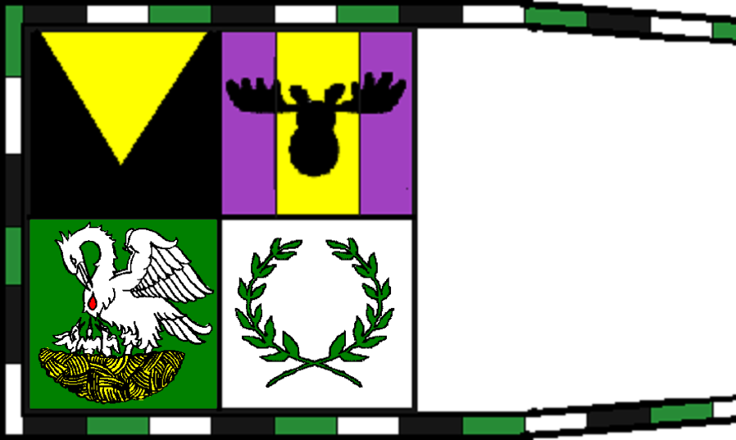
Layout process – Optional Badges
Take the first square of the banner (22"x22") and make into an identifier box.
  Single element
  Multiple elements
Ideas to Choose from:
  Kingdom badge
  Local group badges
  Household badges
  Award badges

Slide 14
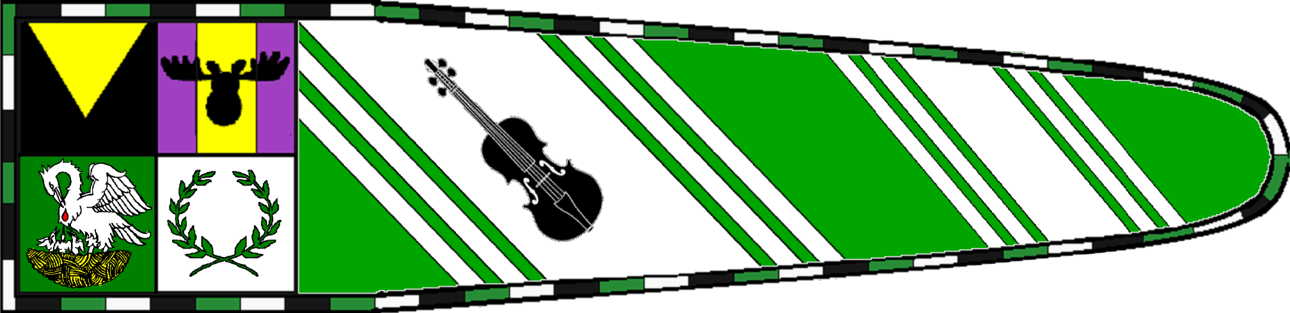
Layout process – Add Heraldic Charges
Add elements of personal heraldry
Add multiples
Omit charges or divisions
Add other charges or division
Add motto

Slide 15
Additional Information
Many resources re available online
http://www.larsdatter.com/banners.htm
http://www.vikingage.org/wiki/wiki/Banners
Medieval painted flags: http://destrier.net/astonhall/article_medieval_painted_flags.20070501.pdf
Making a Silk Standard: http://www.james-gang.org/wolfpack/Giliana/Documents/Silk_Standards.pdf

